Slide 1

Edge Computing and the Internet of Things
David Solomon
Technical Evangelists
February 28th 2018 – New York, NY

Slide 2
1
Introduction
3
Internet of Things (IoT)
4
Computing at the Edge
5
IoT Technologies
2
Sensing the World

Slide 3





About Me
Focus / Passion
AI, Cognitive, Emerging Technology
Analytics
Data (Architecture, Modeling, Integration)
Cloud Service Architecture
Applying the above to real-world business problems
Education & Certification
M.S. Software Engineering
B.S, Physics
Data Mgmt, AI, Cloud, Docker, DevOps, …
David Solomon
Technical Evangelist, IBM
Proud Member of the IBM WolfPack
dsdlsolomo
@dlsolomo
Team-wolfpack

Slide 4
Sensing the World
Sensors are not a new concept

Slide 5
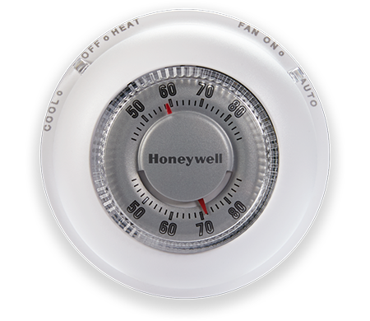
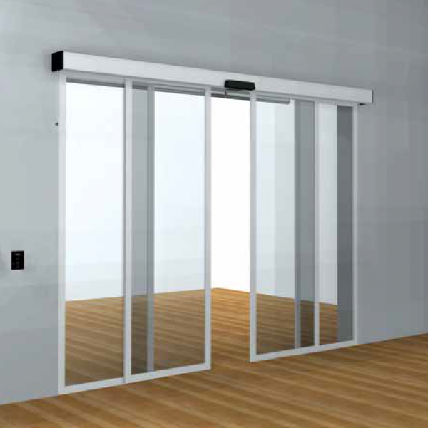
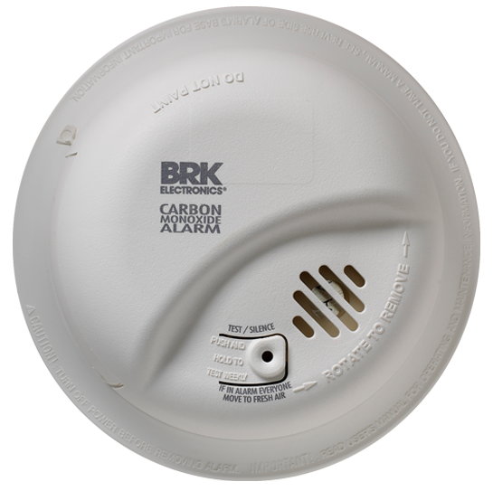
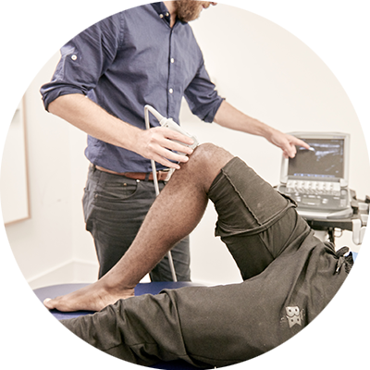
Sensing the World
sensors have been with us for a while now
Mostly Disconnected
Temperature
Proximity
Gas
Pressure
Notes:
https://www.finoit.com/blog/top-15-sensor-types-used-iot/
https://yourhome.honeywell.com/~/media/epresence/product%20images/the%20round/the-round-hero.ashx
https://tse3.mm.bing.net/th?id=OIP.kW1K4RHwJ_-NX1onsQUhTAHaHa&pid=15.1&P=0&w=300&h=300
https://brkcanada.ca/co-alarms-and-detector
https://complete-physio.co.uk/wp-content/uploads/2017/09/ULTRASOUND-GUIDED-INJECTION.png
https://www.statista.com/statistics/471264/iot-number-of-connected-devices-worldwide/

Slide 6
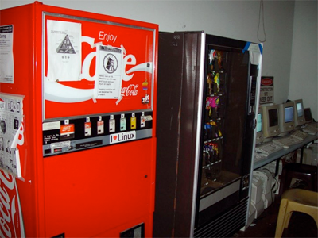
Sensing the World
Necessity is the mother of invention
Carnegie Mellon (1982)
Computer Science Department
Lazy Graduate Students
Wired Coke Machine (can count, temp)
Communication via ARPNET
The First “Connected” Device
Notes:
http://i0.kym-cdn.com/entries/icons/original/000/004/112/internet-coke-machine.png
https://www.cs.cmu.edu/~coke/history_long.txt
https://connectedworld.com/the-evolution-of-smart-coca-cola-vending-machine/

Slide 7
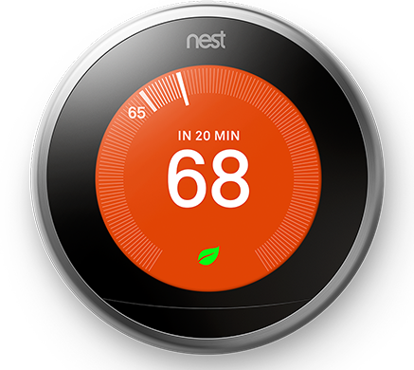
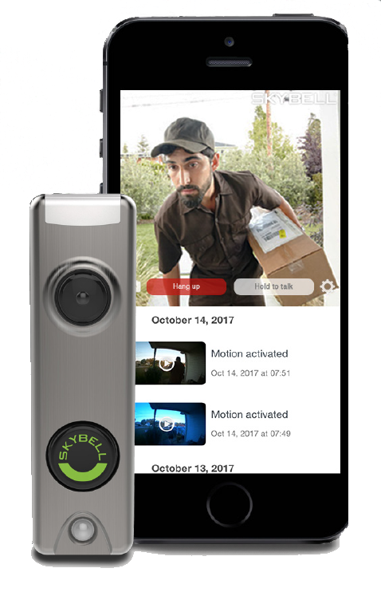
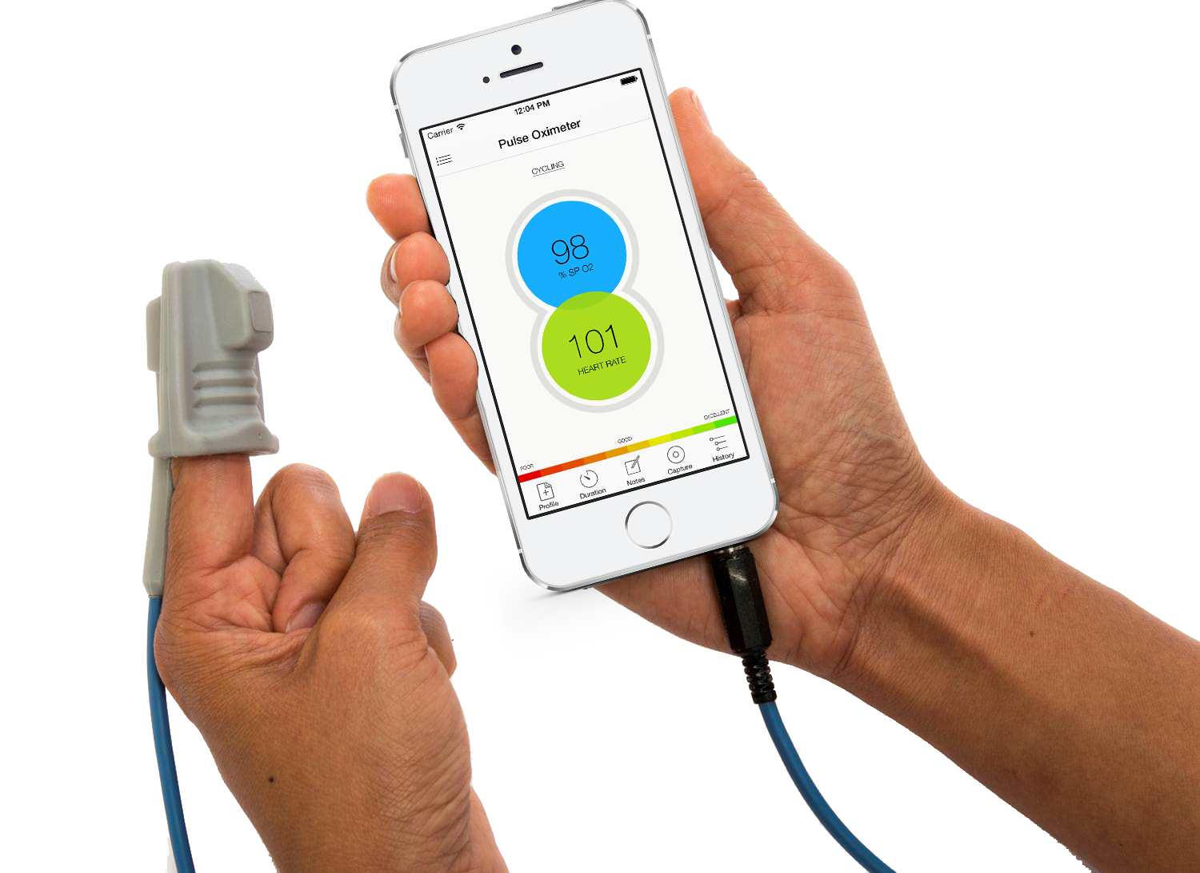
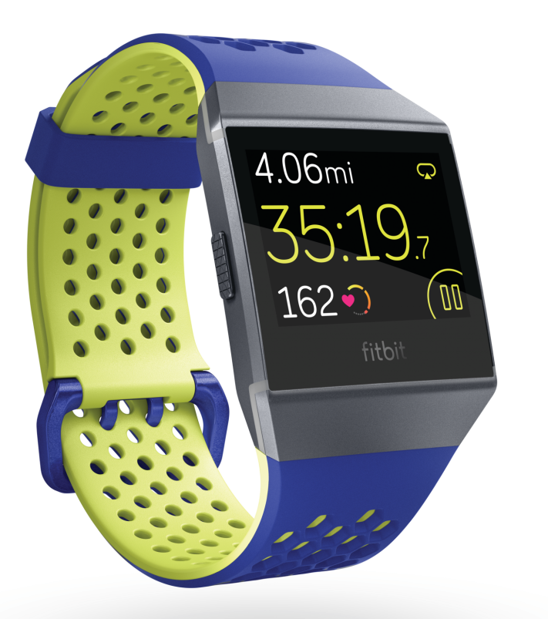
Sensing the World
Sensors are now smart
Mostly Connected
Temperature
Motion / IR
Optical
Accelerometer
Notes:
http://www.kurzweilai.net/images/The-Phone-Oximeter-phone-and-sensor.png
http://adssecurity.com/Portals/0/Images/Landing_Pages/skybellphonelockup.png?ver=2017-11-17-153635-990
http://www.stat-wellness.com/wp-content/uploads/2017/03/simple.b-cssdisabled-png.h9ea2e0e97be14fd866284b0b3ead6a0a.png
https://lh3.googleusercontent.com/yh_FOJDMX2UElM7QoYcwHzz-ColczTdwnPPUQoFcJHNqXETeYUTsJTMnpgTAtGXNqsA

Slide 8
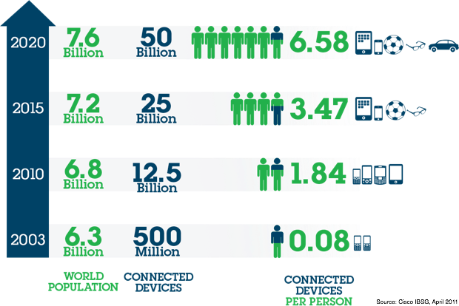
Sensing the World
billions of connected devices
Notes:
https://s-media-cache-ak0.pinimg.com/originals/f5/65/3c/f5653c140e4501d607da05b9fab40ef6.jpg

Slide 9
Internet of Things (IoT)

Slide 10
Internet of Things
A definition
“The Internet of things (IoT) is the network of physical devices, vehicles, home appliances and other items embedded with electronics, software, sensors, actuators, and connectivity which enables these objects to connect and exchange data.”
Notes:
https://en.wikipedia.org/wiki/Internet_of_things
The IoT allows objects to be sensed or controlled remotely across existing network infrastructure, creating opportunities for more direct integration of the physical world into computer-based systems, and resulting in improved efficiency, accuracy and economic benefit in addition to reduced human intervention.

Slide 11
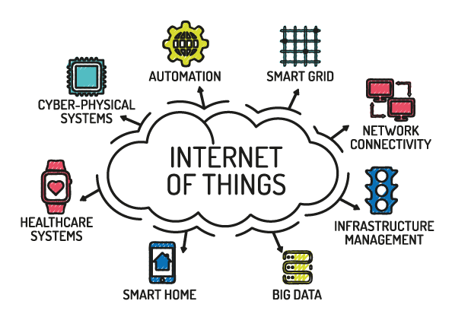
Internet of Things
ioT in perspective
Notes:
http://www.naveo.mu/images/IoT-01.png

Slide 12
Computing At the Edge

Slide 13
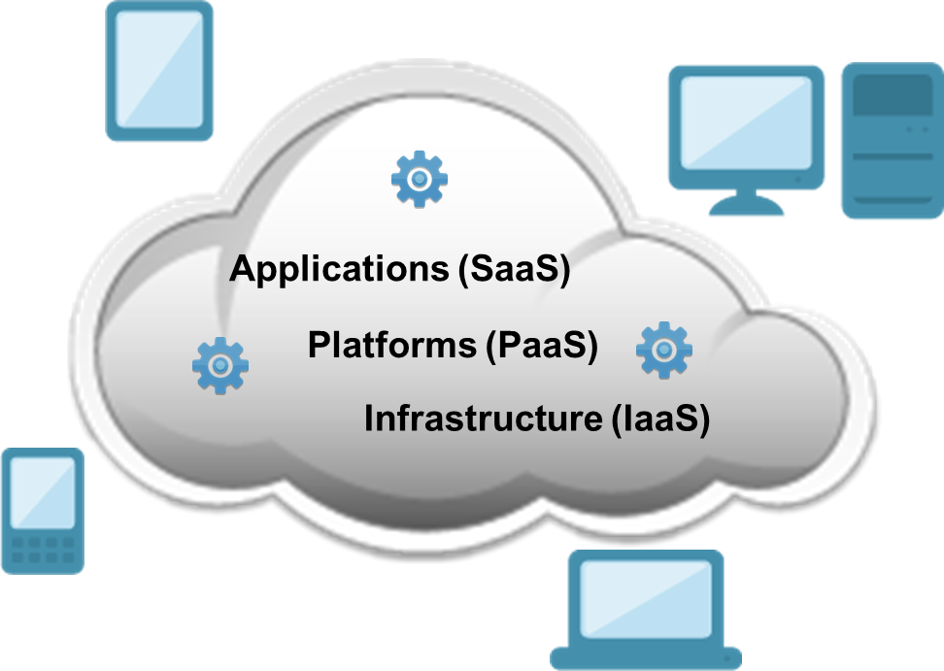
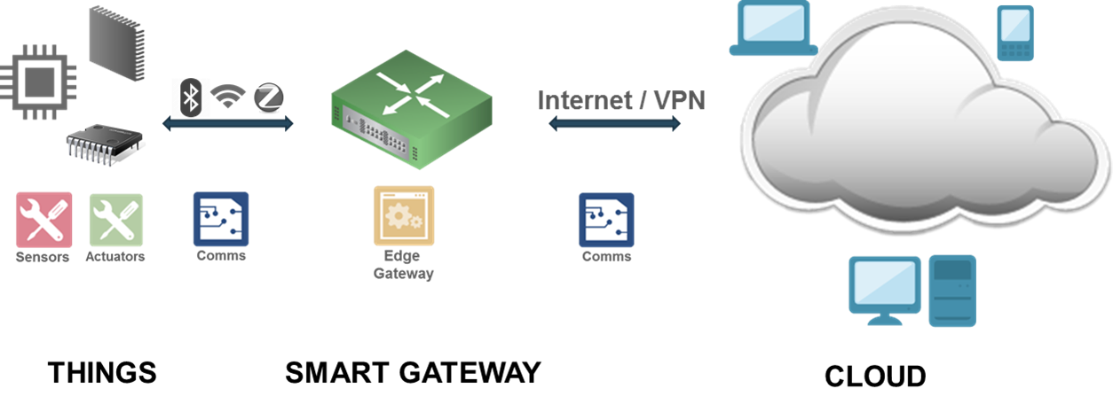
Computing at the Edge
What is the edge?
Notes:
“Edge” refers to the computing infrastructure that exists close to the sources of data that typically resides away centralized computing.
Sensors - Reads and reports real-world status of connected products, machines and environments. Can be physical objects or product-specific output data. May be hardwired, built into a product, or communicate via short-haul comms like ZigBee or BLE
Actuators - Affect the electromechanical or logical state of a product or environment. They are the system’s hands and feet. Light that can be turned on or off, or a value that can be opened and closed.
Devices - Hardware or software component that interacts with sensors and actuators. May be fused with other components of the stack. Can be as simple as circuit that reads an analog signal from a temp sensor and digitizes signal into a discrete transmissions that the upper layers of the stack can understand.
Gateways - Embedded program/device that runs near the IoT device and reports the status of an asset or environment.

Slide 14
Computing at the Edge
A Reference architecture
Cloud / On-Premises
Long-haul
Communications
Internet
Gateway
Bridge Between Controller & Cloud
Device / Controller
HDW or SW Component that Interacts with Sensors & Actuators
Short-haul
Communications
Sensors / Actuators
Read and Report Status of Thing
Thing
Notes:
https://www.oreilly.com/ideas/the-edge-of-the-iot
Sensors
Sensors read and report on the real-world status of connected products, machines, and local environments. They are the eyes and ears of the system, monitoring environmental elements like temperature, light, and moisture. Ongoing sensor innovation, an often-overlooked area of IoT technology, will be critical for evolving and improving solutions.
Actuators
Actuators affect the electromechanical or logical state of a product or environment. They are the system‚Äôs hands and feet. Actuators might include a light that can be turned on and off, or a valve that can be opened and closed.
Controller
The next layer in our stack is the¬†controller, a hardware or software component that interacts electrically or logically with sensors and actuators. It is in the controller that we‚Äôll find our low-level, short-haul communication.
While in many instances the controller may be fused within other elements of the stack, it is always present logically. For example, a controller may be a simple circuit that reads an analog signal from a temperature sensor and digitizes the signal into discrete transmissions that the upper layers of the stack can understand.
Over short distances, local communication from sensors can come via a simple serial connection between devices, or short-haul wireless technologies like ZigBee. Industries may define standard protocols for interfacing with equipment‚Äîfor example, OBD-II for automobiles, or DEX and MDB for vending machines. All of these represent short-haul protocols, because they are meant for local communication between sensors, control systems, and an agent.
Gateway
The next layer in the stack is the¬†agent, an embedded program that runs on or near the IoT device and reports the status of an asset or environment. The agent acts as a bridge between the controller and the cloud, deciding what data to send and when to send it. This process operates in reverse as well, as the agent processes and responds to cloud-based commands and updates.
As an example of the controller and agent working in concert, imagine that we‚Äôre engineering a proof-of-concept device for an IoT system using a Raspberry Pi and an Arduino with a breadboard. The Arduino is the¬†controller¬†running LEDs and servos, and acquiring data from a sensor. The Raspberry Pi is interfacing with the Arduino, and running a software¬†agentthat decides when to send the sensor data to the cloud, via a long-haul connection to WiFi / Ethernet.
Long-haul communication
On the top layer of our architecture, we find our long-haul communication to the Internet. IoT solutions invariably require that environment or device status be made available to a cloud-based application for consumption by a variety of stakeholders. Once an agent has received information via short-haul, it must retransmit that information to the cloud. The desired characteristics of these long-haul protocols are much different than short-haul, particularly in the categories of security, footprint, and reliability. There are a wide variety of long-haul options for IoT solutions, dependent on the use case; they include cellular and satellite, WiFi and wired Ethernet, as well as subgigahertz options like LoRa and SigFox.
Networking protocols for long-haul communication are similarly diverse; they include TCP (Transmission Control Protocol) and UDP (User Datagram Protocol) for the transport layer, and HTTP (Hypertext Transfer Protocol) and CoAP (Constrained Application Protocol) for the application layer, among many others.

Slide 15
Computing at the Edge
Motivating factors for edge computing
Preserve Privacy
Reduce Latency
Minimize Network Traffic
Localized Analytics and Decision Making
Be Robust to Connectivity Issues
Notes:
https://www.techopedia.com/2/32118/it-business/business-intelligence-bi/living-on-the-edge-the-5-key-benefits-of-edge-analytics
https://www.oreilly.com/ideas/the-edge-of-the-iot
Edge computing or fog computing—a paradigm championed by some of the biggest IoT technology players, including Cisco, IBM, and Dell—represents a shift in architecture in which intelligence is pushed from the cloud to the edge, localizing certain kinds of analysis and decision-making. Edge computing enables quicker response times, unencumbered by network latency, as well as reduced traffic, selectively relaying the appropriate data to the cloud.
Regardless of whether system intelligence is ultimately located in the cloud or the fog or some hybrid of the two, development for the Internet of Things requires technologists to have a clear understanding of edge architecture and how information is both gathered from devices and communicated.
https://www.ibm.com/blogs/internet-of-things/edge-iot-analytics/
1. Preserve privacy
Data captured by IoT devices can contain sensitive or private information, e.g., GPS data, streams from cameras, or microphones. While an application might want to use this information to run complex analytics in the Cloud, it is important that, whenever data leaves the premises where it is generated, the privacy of sensitive content is preserved. With Edge Computing, an application can make sure that sensitive data is pre-processed on-site, and only data that is privacy compliant is sent to the Cloud for further analysis, after having passed through a first layer of anonymizing aggregation.
2. Reduce latency
The power and flexibility of Cloud computing has enabled many scenarios that were impossible before. Think about how the accuracy of image or voice recognition algorithms has improved in recent years. However, this accuracy has a price: the time needed to get an image or a piece of audio recognized is significantly affected by the non-negligible yet unavoidable network delays due to data being shipped to the Cloud and results computed and sent back to the edge. When low-latency results are needed, Edge Computing applications can implement machine-learning algorithms that run directly on IoT devices, and only interact with the Cloud off the critical path, for example, to continuously train machine learning models using captured data.
3. Be robust to connectivity issues
Designing applications to run part of the computation directly on the Edge not only reduces latency, but potentially ensures that applications are not disrupted in case of limited or intermittent network connectivity. This can be very useful when applications are deployed on remote locations where network coverage is poor or even to reduce costs coming from expensive connectivity technologies like cellular technologies.

Slide 16
Technology

Slide 17
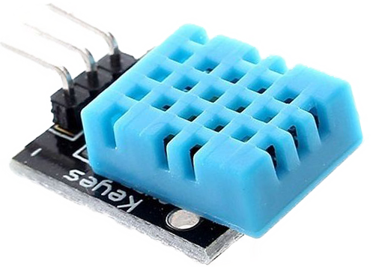
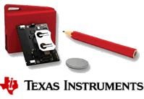
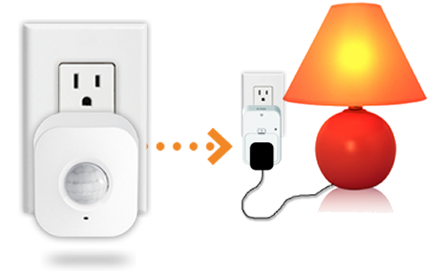
Technology
Sensors
Humidity
Light
Water Quality
Chemical
Smoke
IR
Level
Image
Motion
Accelerometer
Gyroscope
Optical
Notes:
https://www.oreilly.com/ideas/the-edge-of-the-iot

Slide 18
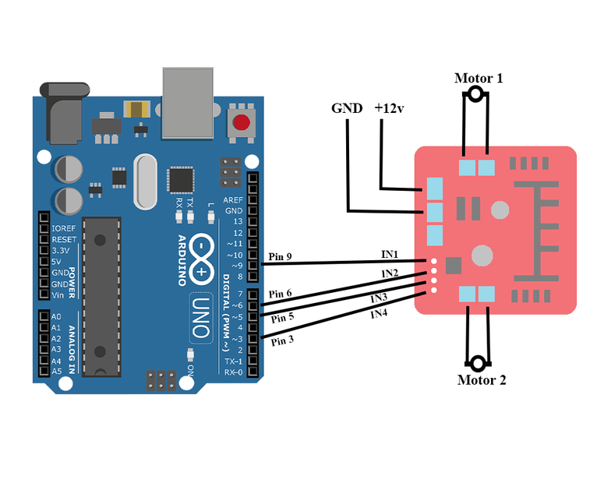
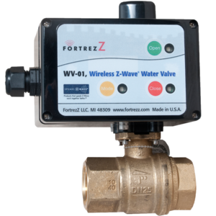
Technology
actuators
Lights
Valves
Motors
Notes:
https://www.oreilly.com/ideas/the-edge-of-the-iot

Slide 19
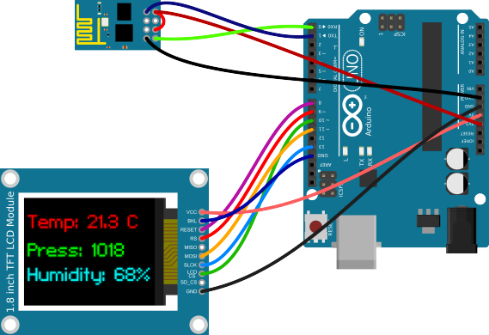
Technology
controller
Arduino
Notes:
https://www.oreilly.com/ideas/the-edge-of-the-iot

Slide 20
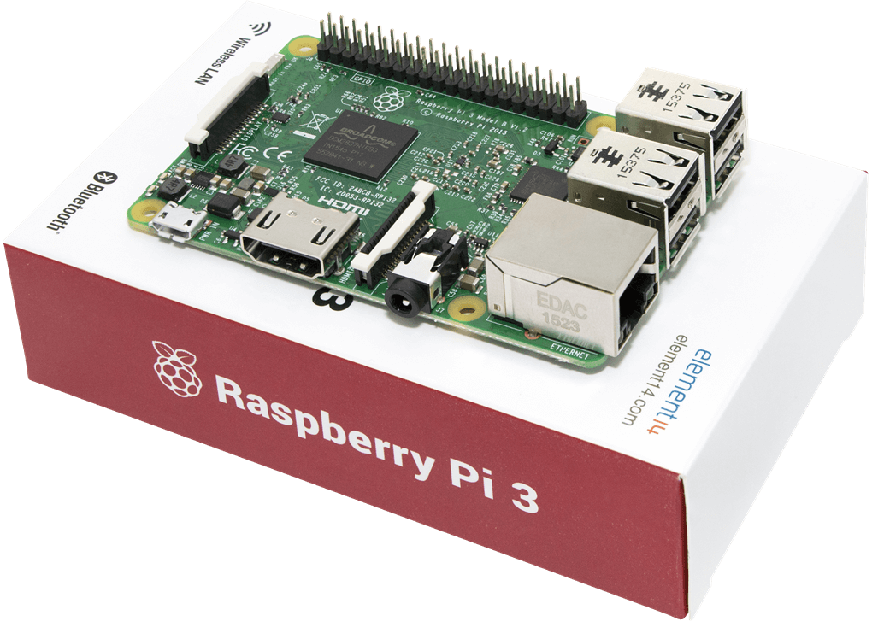
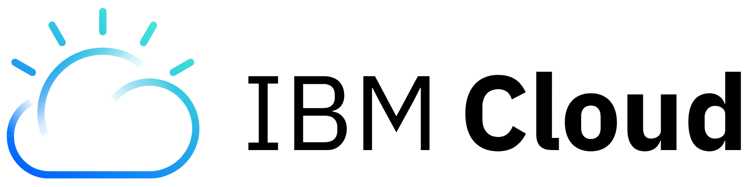
Technology
Gateways
Raspberry PI
Platform
Notes:
https://www.oreilly.com/ideas/the-edge-of-the-iot

Slide 21
Technology
Iot Protocols
Bluetooth Low Energy (BLE)
- Similar to Bluetooth but designed for significantly reduced power consumption.
Zigbee
- Used mostly in industrial settings. High security for M2M and IoT applications.
Z-Wave
- Low power RF communications technology used primarily in home automation products.
Cellular
- Good for low bandwidth data, especially due to cost.

Slide 22
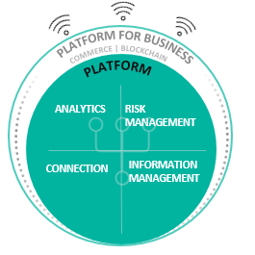
The IBM Watson IoT Platform
Connect Connect and manage devices, networks and gateways.
Analytics Gain insights from information using real-time streaming as well as machine learning and cognitive analytics in the cloud and at the edge.
Risk Management Visualize the IoT landscape, manage risk, and build trusted sources of IoT data with innovative technology such as blockchain.
Information Management Integrate information, structured and unstructured, from devices, people, the weather and the world around us.
ANALYTICS
CONNECTION
INFORMATION MANAGEMENT
22

Slide 23
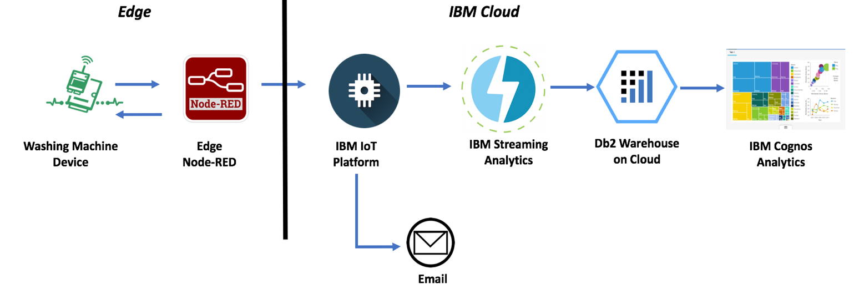
Example IoT Workflow Using the IBM Cloud
We will see this in action in today’s lab

Slide 25
Edge Analytics

Slide 26
Edge Analytics
Batch to Real-time
Discuss batch, near-time, and real-time analysis in the context of Edge/Cloud

Slide 27
Deployment Models
Siloed, or Edge only
Discuss typical edge scenarios: Siloed, Edge Only.

Slide 28
Deployment Models
Edge + Cloud

Slide 29
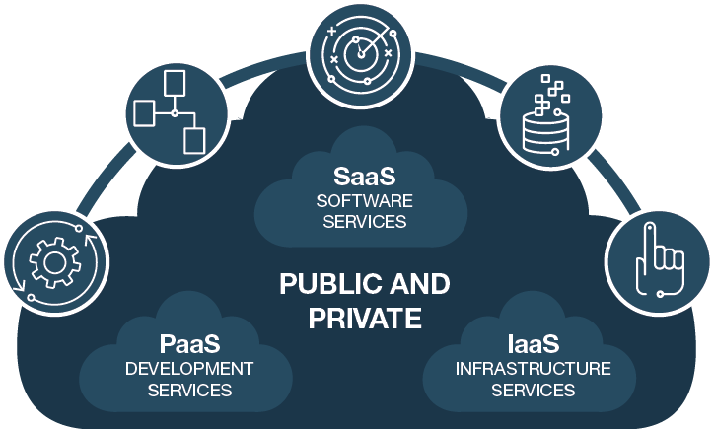
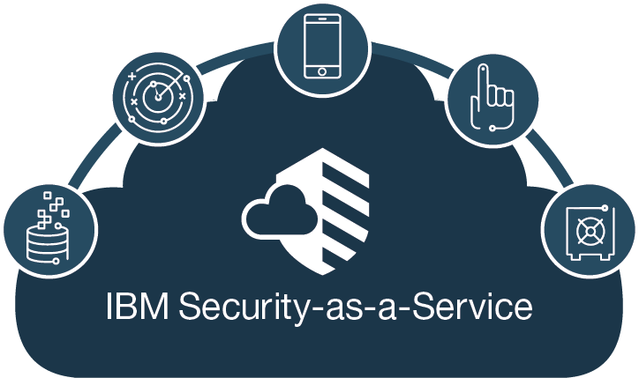
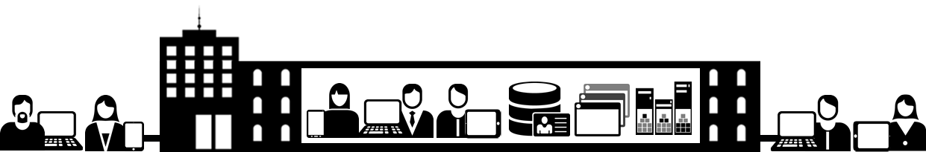
Cloud security capabilities from IBM Security help deliver cloud services
Intelligence
Mobile
Network
Data
Analytics
Access
Secure
DevOps
Access
Apps
Fraud
Deliver security FOR the cloud
Consume security FROM the cloud
ACCESS
MANAGEMENT
NETWORK
SECURITY
DATA
PROTECTION
APPLICATION
SECURITY
VISIBILITY &
INTELLIGENCE
WORKLOAD
MANAGEMENT
Notes:
It is natural for any responsible business leader to have concerns regarding the transfer control to a third party but the economics of cloud computing is pushing more organizations to utilize external IT environments.
IBM Security can help organizations securely deliver to and from the cloud by leveraging business application software such as Box, Google Apps, Kenexa, Salesforce, Workday; Development services such as IBM Bluemix, Windows Azure, Software Force; And Infrastructure services like Openstack, Softlayer, vmware, Amazon Web Services.
IBM Cloud Security Solutions and Services help organizations:
MANAGE ACCESS: Safeguard people, applications, and devices connecting to the cloud (Cloud Identity Management - Cloud Access Management - Cloud Identity Services)
PROTECT DATA: Identify vulnerabilities and help prevent attacks targeting sensitive data (Cloud Application Security - Cloud Network Protection - Cloud Endpoint Security Management )
GAIN VISIBILITY: Monitor the cloud for security breaches and compliance violations (Cloud Security Intelligence)
OPTIMIZE SECURITY OPERATIONS: Deliver a consolidated view of your security operations – at unprecedented speed and agility (Cloud Security Managed Services - Security Intelligence and Operations Consulting)
IBM is one of the largest cloud providers in the industry, with thousands of customers using cloud products. We offer flexible and scalable managed security services from the cloud for organizations that may lack the internal resources needed to transform their business.
IBM’s portfolio of security products are “cloud ready”, meaning that they help protect clients’ people, data, applications and infrastructure as they build their private clouds. IBM also offers the tools that allow organizations visibility into cloud-based infrastructure in monitor for security breaches and compliance violations. We also work with many of the largest cloud service providers and telecommunications companies in the world to help them build security into their cloud offerings.
At IBM, data privacy and security are not afterthoughts or “the cost of doing business.” IBM continues our long tradition of privacy and security leadership because data security and privacy have been essential values of our organizational culture for decades.

Slide 30






Applications (SaaS)
Platforms (PaaS)
Infrastructure (IaaS)

Slide 31
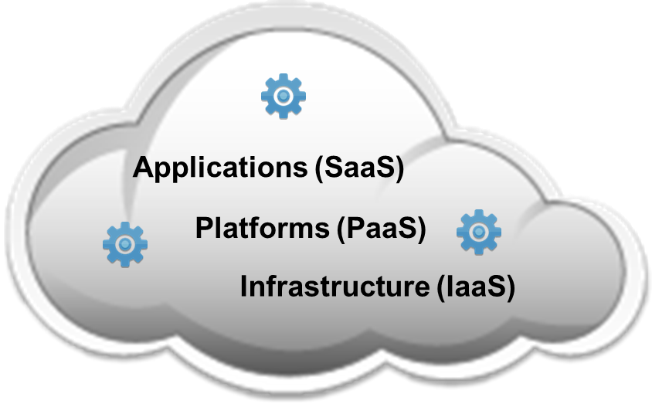
Applications (SaaS)
Platforms (PaaS)
Infrastructure (IaaS)

Slide 32




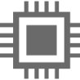
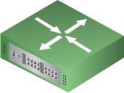



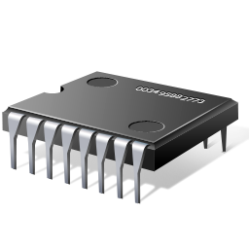


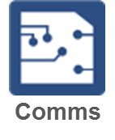
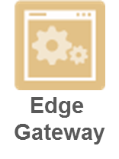

Internet / VPN
THINGS
SMART GATEWAY
CLOUD

Slide 33
Computing at the Edge
Breaking it down
Usually comprised of:
Sensors - Reads and reports real-world status of connected products, machines and environments. Can be physical objects or product-specific output data. May be hardwired, built into a product, or communicate via short-haul comms like ZigBee or BLE
Actuators - Affect the electromechanical or logical state of a product or environment. They are the system’s hands and feet. Light that can be turned on or off, or a value that can be opened and closed.
Devices - Hardware or software component that interacts with sensors and actuators. May be fused with other components of the stack. Can be as simple as circuit that reads an analog signal from a temp sensor and digitizes signal into a discrete transmissions that the upper layers of the stack can understand.
Gateways - Embedded program/device that runs near the IoT device and reports the status of an asset or environment.
Notes:
https://www.oreilly.com/ideas/the-edge-of-the-iot

Slide 34
Reference Architecture
Bringing ioT into perspective
Cloud
Dashboards, Analytics, Apps
Final persistence. Further processing / Data Mining.
Edge
Pre-processing, Filtering, Aggregation
Analytics and Pre-processing that occurs at the edge of the network.
Devices
Sensors, Actuators, Gateways
Physical sensors and actuators connected to IoT devices.
Notes:
https://www.ibm.com/developerworks/library/iot-lp201-iot-architectures/

Slide 35
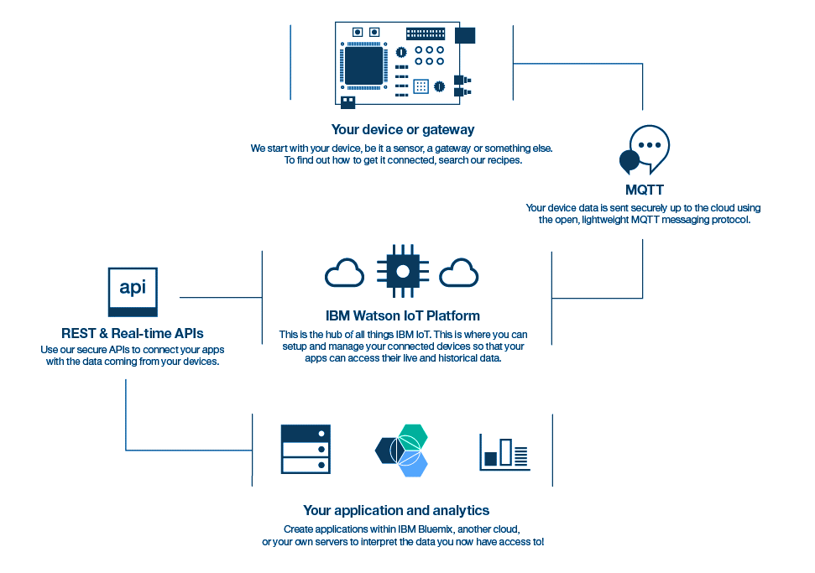
Technology
Watson iot platform
Tight Integration with IBM Cloud
Simplified IoT Data Management
Platform for IoT Analytics, Development & Deployment
Rich Library of IoT Samples

